Slide 1
Day 4 Morning: Analyzing and Interpreting Results
Prof. Shengdong Zhao

Slide 2


4 Stages of Research Pipeline
STAGE 1
Identifying Contribution
STAGE 2
Initial Pilot Testing
STAGE 3
Full Pilot Testing
STAGE 4
Rigorous Experiments
IDEATION
Notes:
Next we discuss factorial design
The factors in the factorial design is synonym to independent variables or IVs
Factorial design typically involves the investigation of two or more factors.
Same example as before. In the earpod vs ipod, there are 2 IVs
Technique has two levels
Breadth has three levels
Thus we call this 2 by 3 factorial design

Slide 3
STAGE 1
Identifying Contributions
STAGE 1
STAGE 2
STAGE 3
STAGE 4
Contribution?
Initial Pilot
Full Pilot
Rigor Exp.
1
What are is your contribution to the community?
2
Why should the community care?
Notes:
Next we discuss factorial design
The factors in the factorial design is synonym to independent variables or IVs
Factorial design typically involves the investigation of two or more factors.
Same example as before. In the earpod vs ipod, there are 2 IVs
Technique has two levels
Breadth has three levels
Thus we call this 2 by 3 factorial design

Slide 4

STAGE 1
Identifying Contributions: Artifacts
STAGE 1
STAGE 2
STAGE 3
STAGE 4
Contribution?
Initial Pilot
Full Pilot
Rigor Exp.
Critical Questions:
Why should the community care?
Is my new solution better than the old one?
How is it better?
Any obvious advantages?
Artifact-Based
Contribution
You are contributing a new
[ technique | approach | system ]
Notes:
Next we discuss factorial design
The factors in the factorial design is synonym to independent variables or IVs
Factorial design typically involves the investigation of two or more factors.
Same example as before. In the earpod vs ipod, there are 2 IVs
Technique has two levels
Breadth has three levels
Thus we call this 2 by 3 factorial design

Slide 5

STAGE 1
Identifying Contributions: Insights
STAGE 1
STAGE 2
STAGE 3
STAGE 4
Contribution?
Initial Pilot
Full Pilot
Rigor Exp.
Critical Questions:
Why should the community care?
Are my results surprising?
What are its implications?
How can it be used?
What is its significance?
Insight-Based
Contribution
You are contributing a new
[ insight | observation | realization ]
Notes:
Next we discuss factorial design
The factors in the factorial design is synonym to independent variables or IVs
Factorial design typically involves the investigation of two or more factors.
Same example as before. In the earpod vs ipod, there are 2 IVs
Technique has two levels
Breadth has three levels
Thus we call this 2 by 3 factorial design

Slide 6
STAGE 1
Identifying Contributions: Examples?
STAGE 1
STAGE 2
STAGE 3
STAGE 4
Contribution?
Initial Pilot
Full Pilot
Rigor Exp.
Can anyone give an example using your own project?
What kind of Contribution?
What are the Critical questions?
For {my project}, I am contributing an Artifact | Insight. I expect that {my project} will be impactful because it…
Notes:
Next we discuss factorial design
The factors in the factorial design is synonym to independent variables or IVs
Factorial design typically involves the investigation of two or more factors.
Same example as before. In the earpod vs ipod, there are 2 IVs
Technique has two levels
Breadth has three levels
Thus we call this 2 by 3 factorial design

Slide 7
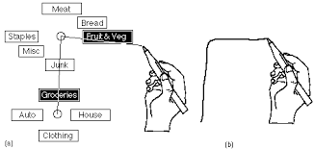
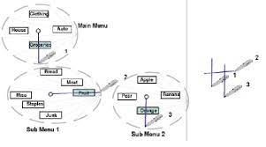
STAGE 1
Identifying Contributions: Examples?
STAGE 1
STAGE 2
STAGE 3
STAGE 4
Contribution?
Initial Pilot
Full Pilot
Rigor Exp.
Compound-stroke marking menu
(State of the Art)
Simple-stroke marking menu
(New Idea)
Notes:
Next we discuss factorial design
The factors in the factorial design is synonym to independent variables or IVs
Factorial design typically involves the investigation of two or more factors.
Same example as before. In the earpod vs ipod, there are 2 IVs
Technique has two levels
Breadth has three levels
Thus we call this 2 by 3 factorial design

Slide 8
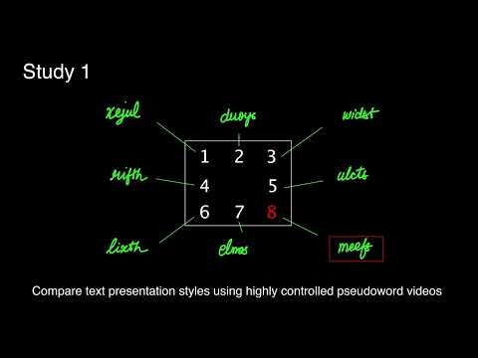
STAGE 1
Identifying Contributions: Examples?
STAGE 1
STAGE 2
STAGE 3
STAGE 4
Contribution?
Initial Pilot
Full Pilot
Rigor Exp.
Conventional belief:
dynamic drawing improves learning
Critical questions?
Interesting Results?
Notes:
Next we discuss factorial design
The factors in the factorial design is synonym to independent variables or IVs
Factorial design typically involves the investigation of two or more factors.
Same example as before. In the earpod vs ipod, there are 2 IVs
Technique has two levels
Breadth has three levels
Thus we call this 2 by 3 factorial design

Slide 9
STAGE 2
Initial Pilot Studies
STAGE 1
STAGE 2
STAGE 3
STAGE 4
Contribution?
Initial Pilot
Full Pilot
Rigor Exp.
1
Does my idea actually work?
2
Are the results what I expected?
3
Is my Hypothesis Wrong?
Notes:
Next we discuss factorial design
The factors in the factorial design is synonym to independent variables or IVs
Factorial design typically involves the investigation of two or more factors.
Same example as before. In the earpod vs ipod, there are 2 IVs
Technique has two levels
Breadth has three levels
Thus we call this 2 by 3 factorial design

Slide 10
STAGE 2
Initial Pilot Studies: Test!
STAGE 1
STAGE 2
STAGE 3
STAGE 4
Contribution?
Initial Pilot
Full Pilot
Rigor Exp.
Conduct Quick and Dirty Pilot tests
Goal: get a good intuition of your project
Priority is low cost, bare minimum
Forget about rigor, focus on Feeling what works and what doesn't. Answer your critical questions!
Do enough to convince yourself that your idea works / Hypothesis is valid!
Notes:
Next we discuss factorial design
The factors in the factorial design is synonym to independent variables or IVs
Factorial design typically involves the investigation of two or more factors.
Same example as before. In the earpod vs ipod, there are 2 IVs
Technique has two levels
Breadth has three levels
Thus we call this 2 by 3 factorial design

Slide 11
STAGE 2
Initial Pilot Studies: Example?
STAGE 1
STAGE 2
STAGE 3
STAGE 4
Contribution?
Initial Pilot
Full Pilot
Rigor Exp.
Can anyone give an example using your own project?
What kind of Feelings or Intuition did you get from your Pilots?
For {my project}} vs SoTA, performance of X is the similar, but Y seems better, especially for Z case.
Notes:
Feeling: for hierarchical menus, speed is comparable, but accuracy seems higher, and it requires less space to operate, especially for menu with higher level of hierarchies.

Slide 12
STAGE 2
Initial Pilot Studies: Example
STAGE 1
STAGE 2
STAGE 3
STAGE 4
Contribution?
Initial Pilot
Full Pilot
Rigor Exp.
Compound-stroke marking menu
(State of the Art)
Simple-stroke marking menu
(New Idea)
Feeling: for hierarchical menus, speed is comparable, but accuracy seems higher, and it requires less space to operate, especially for menu with higher level of hierarchies.
Notes:
Feeling: for hierarchical menus, speed is comparable, but accuracy seems higher, and it requires less space to operate, especially for menu with higher level of hierarchies.

Slide 13
STAGE 2
Initial Pilot Studies: Example
STAGE 1
STAGE 2
STAGE 3
STAGE 4
Contribution?
Initial Pilot
Full Pilot
Rigor Exp.
Conventional belief:
dynamic drawing improves learning
Feeling: dynamic drawing does not improve learning. Type-face font is more preferred
Notes:
Feeling: for hierarchical menus, speed is comparable, but accuracy seems higher, and it requires less space to operate, especially for menu with higher level of hierarchies.

Slide 14
STAGE 3
Full Pilot Studies
STAGE 1
STAGE 2
STAGE 3
STAGE 4
Contribution?
Initial Pilot
Full Pilot
Rigor Exp.
1
Can I prove that my idea works?
2
Do I have evidence to back-up my claims?
Notes:
Next we discuss factorial design
The factors in the factorial design is synonym to independent variables or IVs
Factorial design typically involves the investigation of two or more factors.
Same example as before. In the earpod vs ipod, there are 2 IVs
Technique has two levels
Breadth has three levels
Thus we call this 2 by 3 factorial design

Slide 15
STAGE 3
Full Pilot Studies
STAGE 1
STAGE 2
STAGE 3
STAGE 4
Contribution?
Initial Pilot
Full Pilot
Rigor Exp.
Conduct Full Pilot studies
Goal: Collect Evidence to back-up your claim
Qualitative not enough; Quantitative data need
You need to Convince Others that your idea works!
Study has to be “Fair” and “Clean”
Notes:
Next we discuss factorial design
The factors in the factorial design is synonym to independent variables or IVs
Factorial design typically involves the investigation of two or more factors.
Same example as before. In the earpod vs ipod, there are 2 IVs
Technique has two levels
Breadth has three levels
Thus we call this 2 by 3 factorial design

Slide 16
STAGE 3
Full Pilot Studies: Proving your claims
STAGE 1
STAGE 2
STAGE 3
STAGE 4
Contribution?
Initial Pilot
Full Pilot
Rigor Exp.
Your data has to be statistically significant
Conduct significance testing! (p <.05)
Results are unbiased
Potential sources of bias? Different users? Learning effect?
Explain your results! Do your results make sense?
Notes:
Next we discuss factorial design
The factors in the factorial design is synonym to independent variables or IVs
Factorial design typically involves the investigation of two or more factors.
Same example as before. In the earpod vs ipod, there are 2 IVs
Technique has two levels
Breadth has three levels
Thus we call this 2 by 3 factorial design

Slide 17
STAGE 3
Full Pilot Studies: Almost there!
STAGE 1
STAGE 2
STAGE 3
STAGE 4
Contribution?
Initial Pilot
Full Pilot
Rigor Exp.
Congratulations!
You now have a Potential Research Contribution
that is
Interesting and Provable!
Congratulations!
Notes:
Next we discuss factorial design
The factors in the factorial design is synonym to independent variables or IVs
Factorial design typically involves the investigation of two or more factors.
Same example as before. In the earpod vs ipod, there are 2 IVs
Technique has two levels
Breadth has three levels
Thus we call this 2 by 3 factorial design

Slide 18
STAGE 4
Rigorous Experiments and Analysis
STAGE 1
STAGE 2
STAGE 3
STAGE 4
Contribution?
Initial Pilot
Full Pilot
Rigor Exp.
1
What are the limits of my idea?
2
When does it perform better or worse?
Notes:
Next we discuss factorial design
The factors in the factorial design is synonym to independent variables or IVs
Factorial design typically involves the investigation of two or more factors.
Same example as before. In the earpod vs ipod, there are 2 IVs
Technique has two levels
Breadth has three levels
Thus we call this 2 by 3 factorial design

Slide 19
STAGE 4
Rigorous Experiments and Analysis
STAGE 1
STAGE 2
STAGE 3
STAGE 4
Contribution?
Initial Pilot
Full Pilot
Rigor Exp.
Conduct Factorial Experiment
Goal: Understand the limits of your work
How does your hypothesis generalize?
Which Factors to use? How many Factors?
Pick the most important | significant factors
Convince others that your idea works in practice!
Notes:
Next we discuss factorial design
The factors in the factorial design is synonym to independent variables or IVs
Factorial design typically involves the investigation of two or more factors.
Same example as before. In the earpod vs ipod, there are 2 IVs
Technique has two levels
Breadth has three levels
Thus we call this 2 by 3 factorial design

Slide 20
STAGE 4
Rigorous Experiments and Analysis
STAGE 1
STAGE 2
STAGE 3
STAGE 4
Contribution?
Initial Pilot
Full Pilot
Rigor Exp.
Can anyone give an example using your own project?
What kind of Factors do you think would be significant for your project? Why?
For {my project}}, I will explore Factors X, Y and Z because…..
Notes:
Next we discuss factorial design
The factors in the factorial design is synonym to independent variables or IVs
Factorial design typically involves the investigation of two or more factors.
Same example as before. In the earpod vs ipod, there are 2 IVs
Technique has two levels
Breadth has three levels
Thus we call this 2 by 3 factorial design

Slide 21
STAGE 4
Rigorous Experiments and Analysis
STAGE 1
STAGE 2
STAGE 3
STAGE 4
Contribution?
Initial Pilot
Full Pilot
Rigor Exp.
Conventional belief:
dynamic drawing improves learning
Results: dynamic drawing does not improve learning. Type-face font is more preferred
Possible Factors to Explore?
Notes:
Next we discuss factorial design
The factors in the factorial design is synonym to independent variables or IVs
Factorial design typically involves the investigation of two or more factors.
Same example as before. In the earpod vs ipod, there are 2 IVs
Technique has two levels
Breadth has three levels
Thus we call this 2 by 3 factorial design

Slide 22
Some Terminologies
Within-subject vs Between-subject
Factorial Design
Type of Collected Data

Slide 23
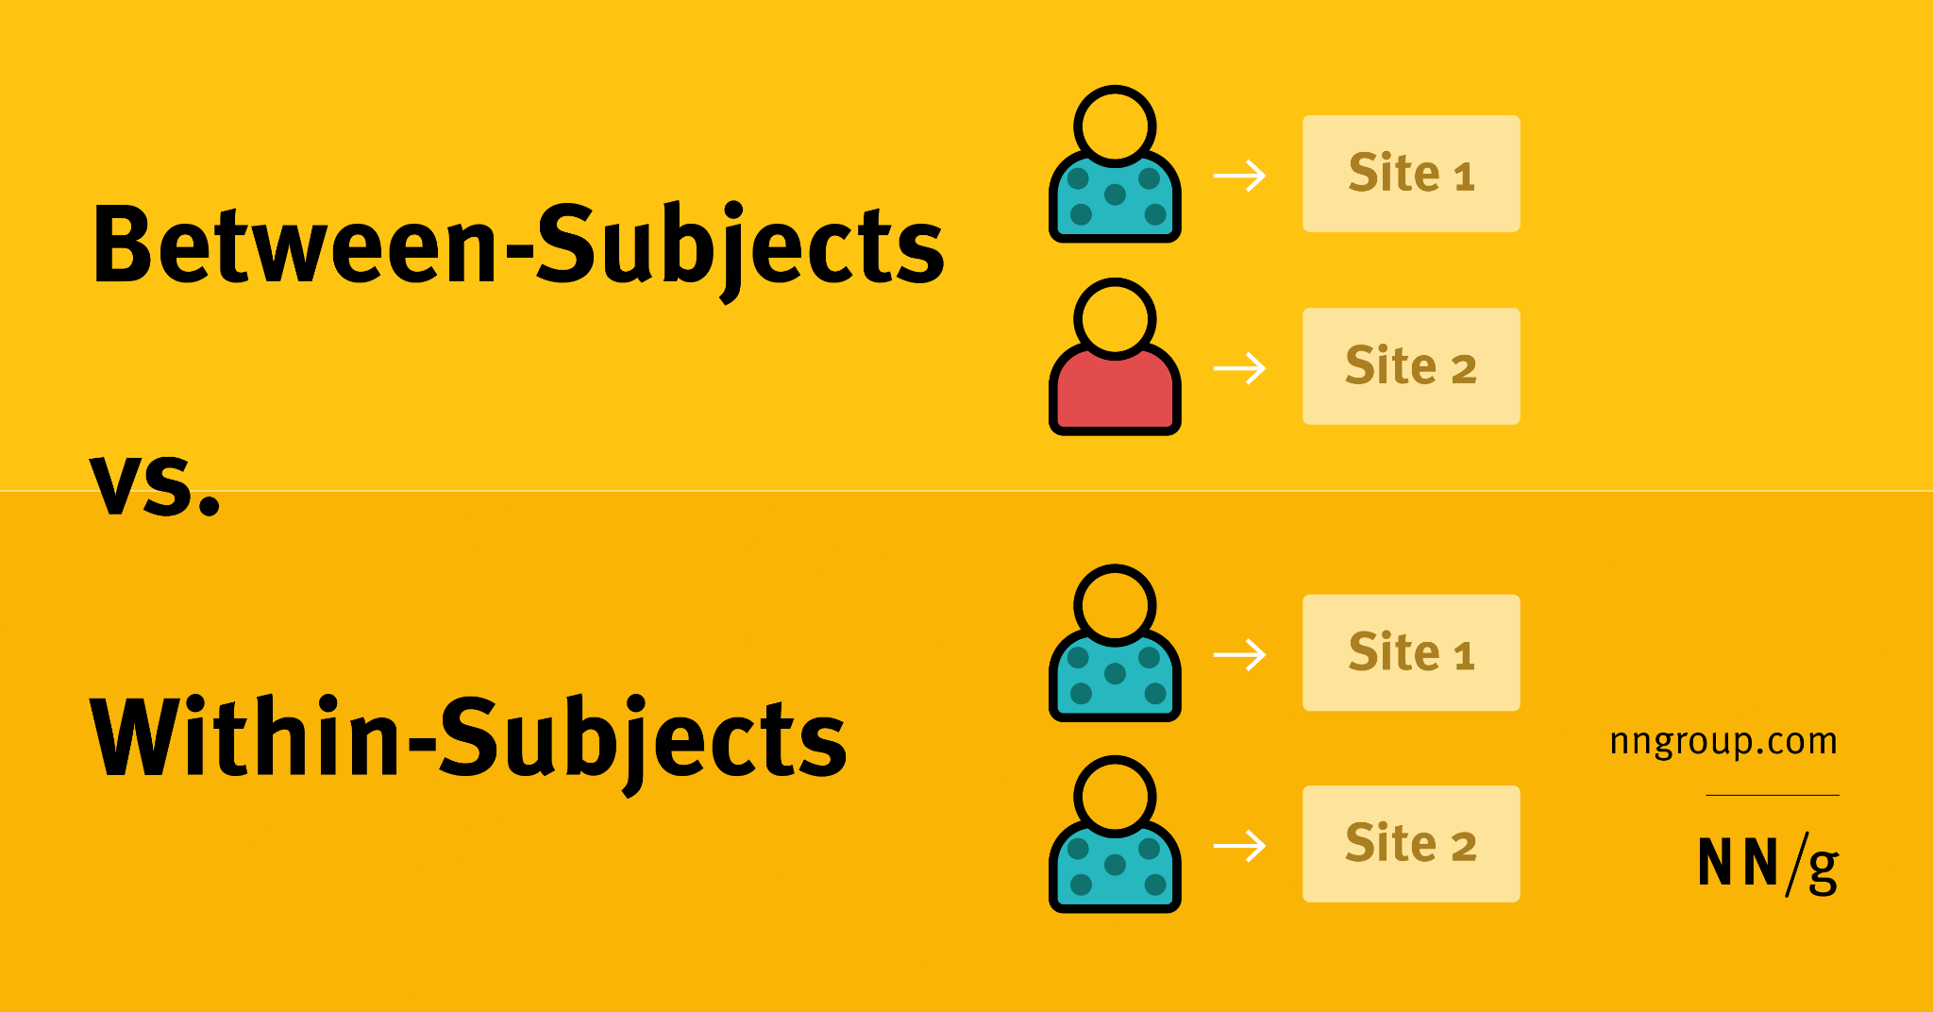
Recap: Within-subject vs. Between-subject
Notes:
Between subject test: One subject is only tested with one site/under one experiment condition. Different conditions are tested on different subjects
Within subject test: one subject is tested with multiple conditions.

Slide 24
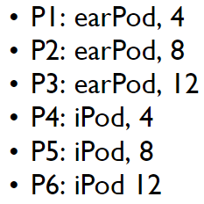
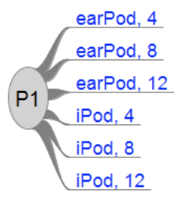
Recap: Within-subject vs. Between-subject
Example: EarPod vs. iPod
Assuming 2 IVs
Technique: EarPod, iPod
Menu breadth: 4, 8, 12
Between-subject We recruit n participants, each given one condition
Within-subject We recruit m participants, each given all conditions
Notes:
Remember the example from last week
We assume there are 2 IVs…
In between-subject test, what we can do
In within-subject test, we can design the test so that

Slide 25
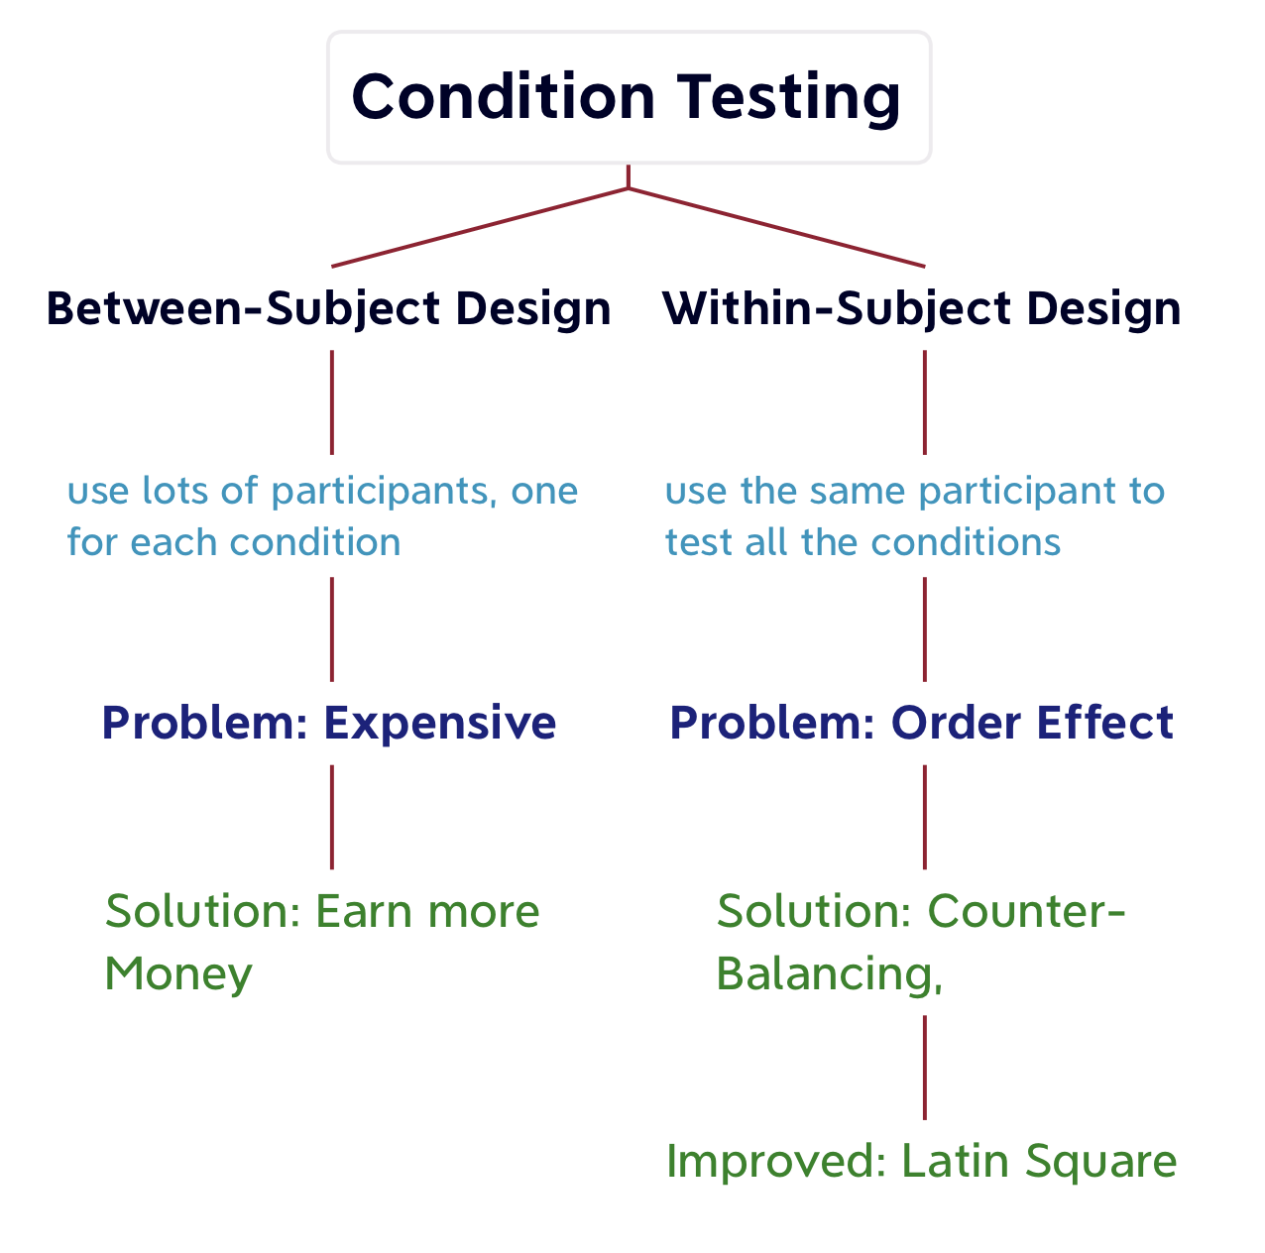
Recap: Within-subject vs. Between-subject
Becomes expensive if full counterbalancing is used
If possible, use within-subject!!!
Notes:
A summary, the problem with between subject test is that it is expensive. One subject is tested with only one condition.
With within subject design, we test multiple conditions on one subject. But this will create order effect. We can mitigate this by using counterbalancing
One thing to note here is that if full counterbalancing is used, this design is equally or more expensive than between subject. Thus we need to carefully choose the counterbalancing measure.
In general, within-subject is preferred for the potential of saving costs.

Slide 26
Factorial Design
Independent variables (IVs) factors
Factorial design two or more factors are investigated simultaneously
Example: EarPod vs iPod
2 IVs (factors)
Technique: 2 levels (EarPod, iPod)
Menu breadth 3 levels (4, 8, 12)
2 x 3 factorial design
Notes:
Next we discuss factorial design
The factors in the factorial design is synonym to independent variables or IVs
Factorial design typically involves the investigation of two or more factors.
Same example as before. In the earpod vs ipod, there are 2 IVs
Technique has two levels
Breadth has three levels
Thus we call this 2 by 3 factorial design

Slide 27
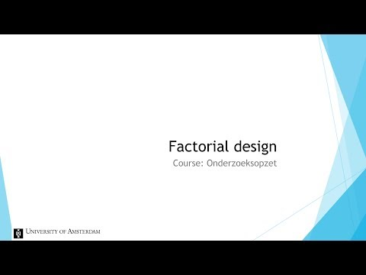
Factorial Design
Notes:
Let’s watch a video

Slide 28
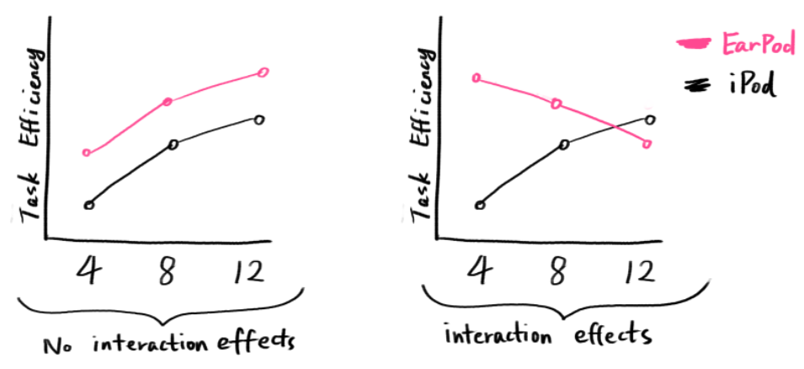
Factorial Design
Interaction Effect: The trend (of measured data/dependent variable) within one factor is different based on the effect of the other factor
Notes:
Interaction effect means…
So still the same example of earpod vs ipod
Pink line refers to earpod
Black is ipod
The x axis is the menu breadth
In the case of the left diagram, we see the similar trend from earpod and ipod of task efficiency with different levels of menu breadth, thus we say there’s no interaction effect between these two factors
On the other hand, on the right diagram

Slide 29
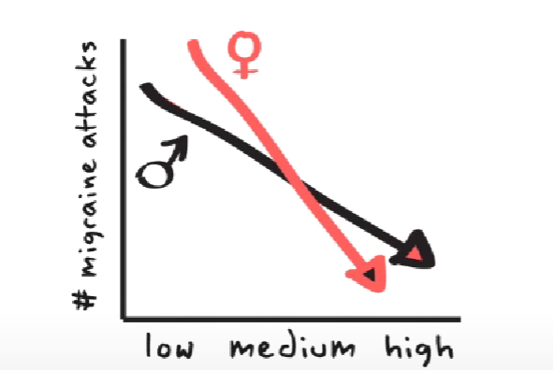
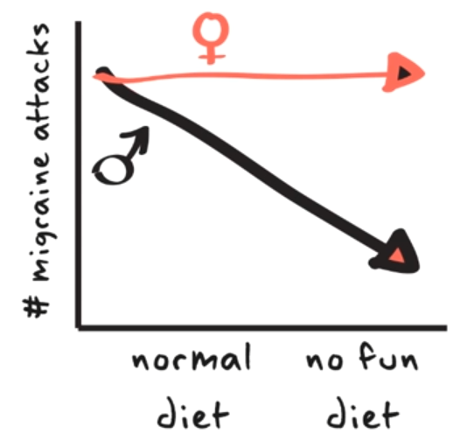
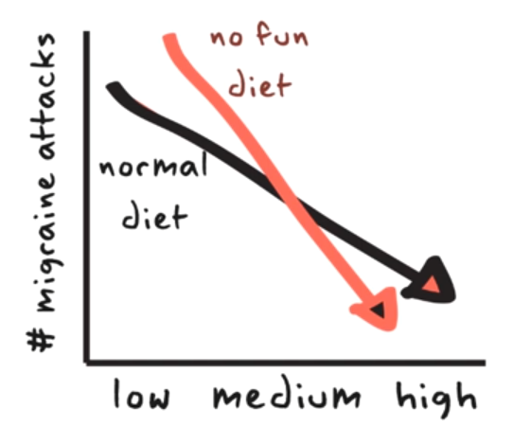
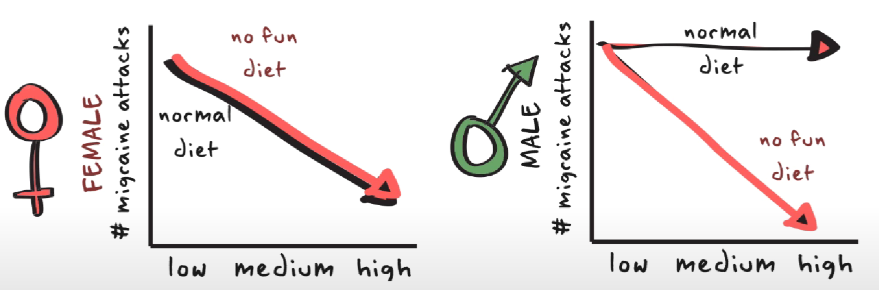
Factorial Design
Two-way Interaction Effect: Interaction between two factors
High-order Interaction Effect: More factors
Notes:
Here are the examples mentioned in the video. The first row of diagram shows two-way interaction effect
What if we are also interested in the effect of gender on the diet-slash-dosage plot?
In other word, we try to combine the second plot and the third plot on the first row to see the high-order interaction effect
The result is shown on the last row.
When more factors come into play we call this high-order interaction effect

Slide 30
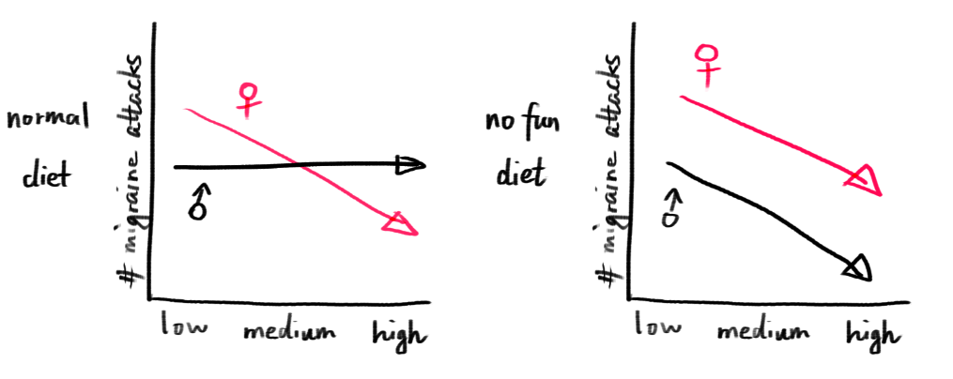
Factorial Design: Quiz 2

Slide 31
Type of collected data (for DVs)
Objectivity
Order and quantifiability
Parametric / Non-parametric
Notes:
Now let’s look at some terminologies related to the type of collected data
First , and the most common categorization, is based on the objectivity of the data.
Some examples of objective data include..
Some examples of subjective data include…

Slide 32
Type of collected data (for DVs)
Objectivity:
Objective
Reaction/completion time
Accuracy (number of correct trials/total number of trials)
…
Subjective
User rating (Likert scale) (in various kind of likert scale -> i.e., in the scale of 1 - 7 rate your satisfaction of the technique, 1 being the least satisfactory, 7 being the most satisfactory)
NASA TLX
Notes:
Now let’s look at some terminologies related to the type of collected data
First , and the most common categorization, is based on the objectivity of the data.
Some examples of objective data include..
Some examples of subjective data include…

Slide 33
Type of data
2. Order and quantifiability - qualitative
Nominal: Categorized information into groups, or classes. No order.
Examples:
Gender
Operating system (Windows, MacOS, Linux)
Ordinal: Ordered categories with logical progression. Differences between two adjacent category not necessarily equal
Examples:
User satisfaction
Task difficulties
Notes:
The second categorization is based on order and quantifiability
So for qualitative data, there are nominal data and ordinal data.
Nominal data contains….
Examples are
Ordinal data, on the other hand, are…
Difference between nominal and ordinal data is whether there is a clear order
For example, gender dont have specific order, but user satisfaction has a clear order
Another characteristic of ordinal data is that the two adjacent…
For example, if we have three levels on the likert scale, (satisfied, not satisfied, neutral) we don’t know whether the satisfaction level between each are equal.

Slide 34
Type of data
2. Order and quantifiability - Quantitative
Interval: Numeric values with equal distances. No zero point.
Examples:
Temperature in degrees Celsius
Time of day
Ratio: Numeric value with zero point.
Examples:
Screen resolution
Battery life
Typing speed
Notes:
For quantitative data, we have interval data and ratio data
Both of these are numeric data, they can be discrete or continuous.
The distinction between these two is whether there is a zero point for the data.
For example, for temperature in degrees celsius, although we have 0 degree, it doesn’t mean the absence of temperature
In contrast, for battery life, there is a clear zero point, which is no battery situation.

Slide 35
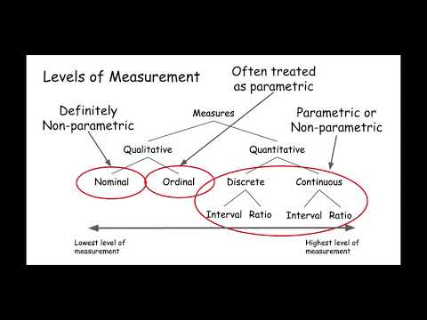
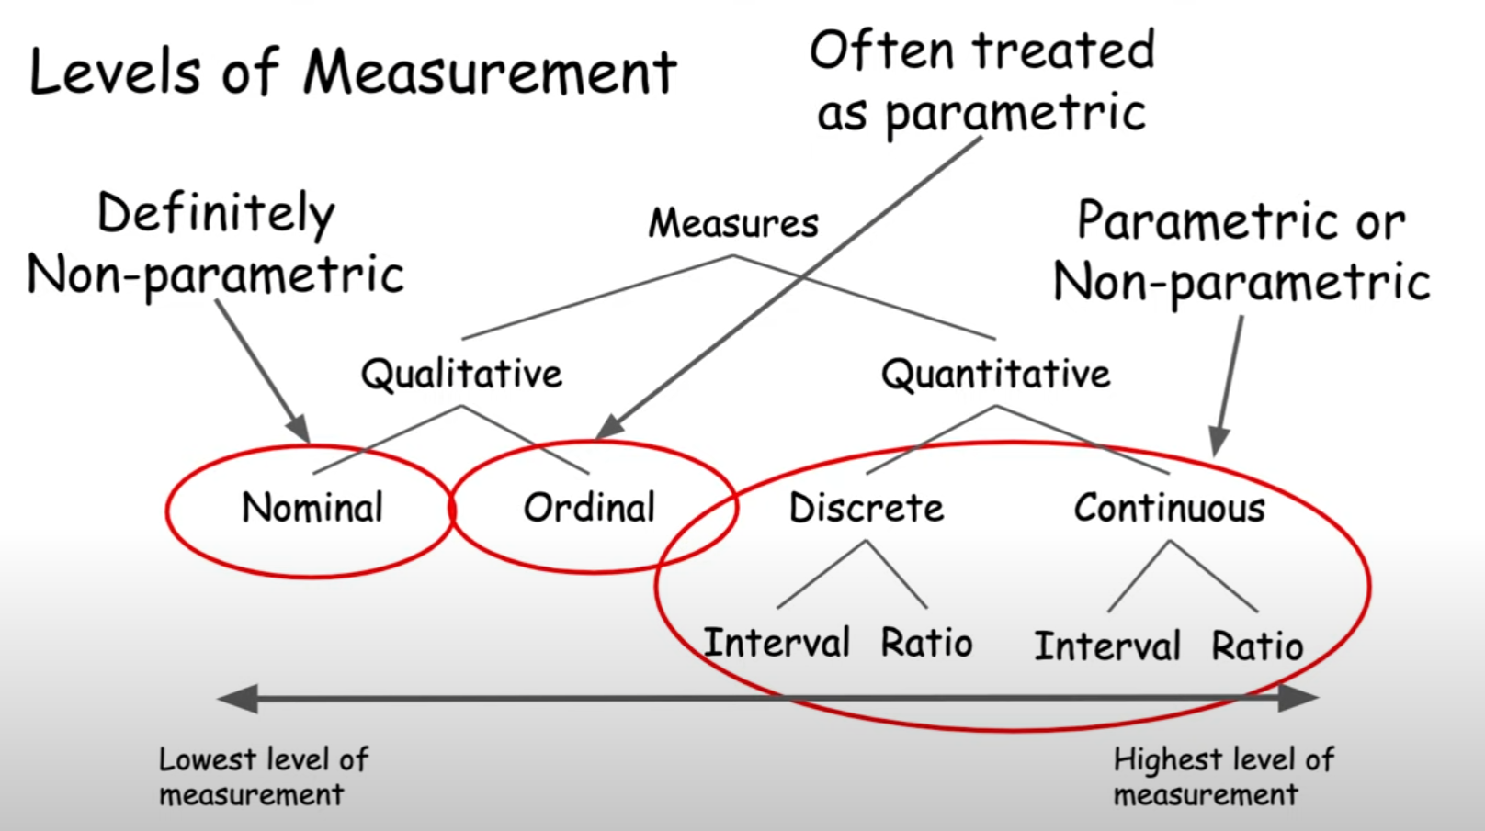

Type of data
3. Parametric / Non-parametric
Notes:
The thrid type of categorization is based on whether the data is parametric.
Let’s watch a video
Before I start, I would like to point out a mistake in this video

Slide 36
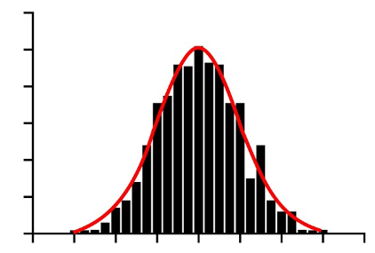
Type of data
3. Parametric / Non-parametric
Based on whether the measured data is treated as normally distributed.
Data need to be continuous / Intervals need to be equally distributed
Notes:
So the only way to tell whether the data is parametric is to test if it is normally distributed in the population.
So when we say we treat the data as parametric data, we assume that it follows the normal distribution.
We also imply that the data is either continuous or the intervals are equally distributed.

Slide 37
Type of data
3. Parametric / Non-parametric
Likert scale
If we do not assume equal distance / less than 5 levels -> ordinal -> non-parametric
If we assume equal distance / equal or more than 5 levels -> interval -> parametric
Notes:
In the case of likert scale, the answer is that it depends.
If we do not assume
Otherwise, if we assume

Slide 38
The methodbox and the most useful methods
Notes:
In the final section, I want to briefly talk about the testing methods we can use for statistical analysis

Slide 39
The methodbox & the most useful methods
What is a “Test”?
Statistical test is a way to find out whether our hypothesis stands true
Null hypothesis: no significant difference or relationship between two or more variable
Alternative hypothesis: there is a significant difference or relationship
In practice, we calculate a “p-value” with different methods, compare it with a provided table, and find out whether the result is significant enough to reject the null hypothesis
Notes:
In the final section, I want to briefly talk about the testing methods we can use for statistical analysis
Firstly, I want to recap on what is a “test” in statistical analysis, which you may already learnt from previous courses.
Statistical test is a way ….
General for a test, we define two types of hypothesis, null means.. Alternative hypothesis is the one we normally want to support,
In practice

Slide 40
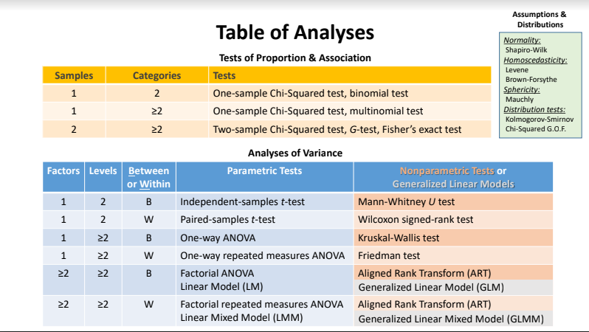
Notes:
Here’s table of different analysis method. These are all the method you will need for your phd thesis. For this lesson we will not look into details of the mathematical equations of each method, but I will generally introduce the purpose of each

Slide 41
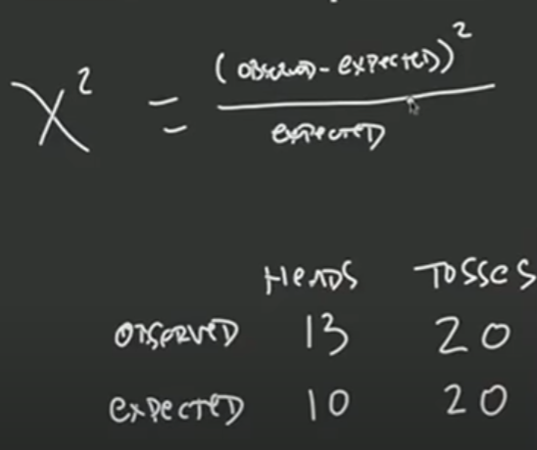
A Test used for non-parametric categorical data
Example:
Coin-tossing 20 times
https://www.youtube.com/watch?v=qLCyuFZMYqY&list=PLLssT5z_DsK_nusHL_Mjt87THSTlgrsyJ&index=31
Test if the design change on a website makes a difference
Notes:
In the first table, there are the testing methods for non-parametric categorical data. These are for testing the proportion and association of the data. A typical example is coin-tossing. Suppose we want to test if the coin is uneven, the null hypothesis would be there’s no significant difference in chances… alternative is, then we toss the coin 20 times, the expect number of heads facing up is 10 for an ideal even coin. The actual number is 13. Then we can use the chi-squred test to check if our result is significant enough to reject the null hypothesis
Another example in the context of HCI is to check if the change of a design makes a difference. For example, if we want to change the design of a button on a website, we can record and compare the click rate before and after the change. And use this test to see if there is a significant difference.

Slide 42
ANOVA: ANalysis Of VAriance
Note that “variance” here refers to the difference of means between different conditions. NOT the statistical variance of a data set.
For EarPod vs. iPod, which should be used?
DV: Task efficiency -> treated as parametric
Two IVs, >= 2 Levels, Within-subject
Notes:
In the second table, there are some methods for the analysis of variance. Noted that the variance here is not the statistical variance, The meaning is the difference of mean for the data under two difference conditions. Take the earpod vs ipod as an example, we want to compare the task efficiency under different conditions. Since task efficiency can be treated as normally distributed ratio data, we can use the parametric test. Remember that we have two IVs or factors. Techniques and menu breadth. And technique has 2 levels, breadth has 3 levels. Thus in this case we can use the factorial… to test.

Slide 43
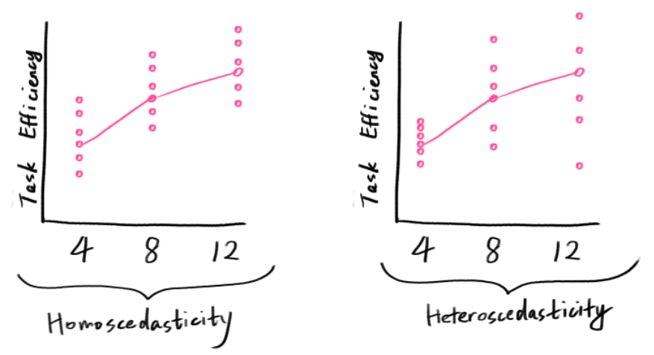
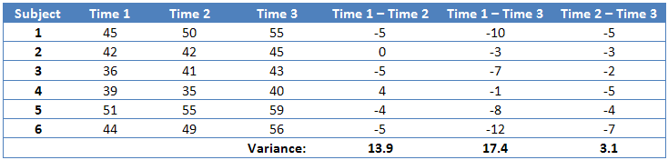
Normality: Parametric or non-parametric
Homoscedasticity: Measure the variance of residuals, or errors, across different levels of a independent variable -> are they constant?
Sphericity: For repeated measures ANOVA -> Measure the variances of differences of means between all pairs of dependent variables. -> are they equal?
Menu Breadth
4
8
12
Notes:
The upper right corner is a set of methods for testing the assumptions and distributions. Normality test is for determine whether our data is suitable for parametric test or non…
Homoscedasticity is a measure of the variance of residuals. Look at the two plots as an example. The two plots have the similar trends, but the distribution of the actual data are different.
We call the one on the left homoscedasticity distribution and on the right hetero…
Finally, sphericity is used for repeated measures ANOVA, it is for measure of the variances of differences of means between all pairs of DVs. the table below shows how this calculation is done.
We can see that in this case there’s a large difference in the variances. Thus we need to utilise some correction method upon this dataset.

Slide 44
Notes:
For recommendation, we normally use the methods highlighted in the red boxes.

Slide 45
Notes:
And to further narrow down, you can start from the four within-subject methods.

Slide 46

Introducing
Jasp

Slide 47
How to report results?
General structure
Step 1 : A brief description of the independent and dependent variable.
Step 2 : The overall F-value of the ANOVA and the corresponding p-value.
Step 3 : The results of the post-hoc comparisons (if the p-value was statistically significant).

Slide 48
How to report results?
A [one-way ANOVA] was performed to compare the effect of [independent variable(s)] on [dependent variable].
brief description
A [one-way ANOVA] revealed that there [was or was not] a statistically significant difference in [dependent variable] between at least two groups (F(between groups df, within groups df) = [F-value], p = [p-value]).
ANOVA results : F-values
[Tukey’s HSD Test] for multiple comparisons found that the mean value of [dependent variable] was significantly different between [group name] and [group name] (p = [p-value], 95% C.I. = [lower, upper]).
Post-hoc : positive result
There was no statistically significant difference between [group name] and [group name] (p=[p-value]).
Post-hoc : negative result

Slide 49
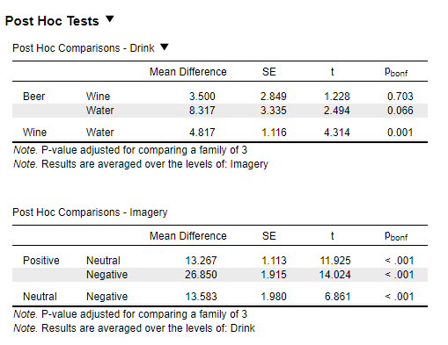
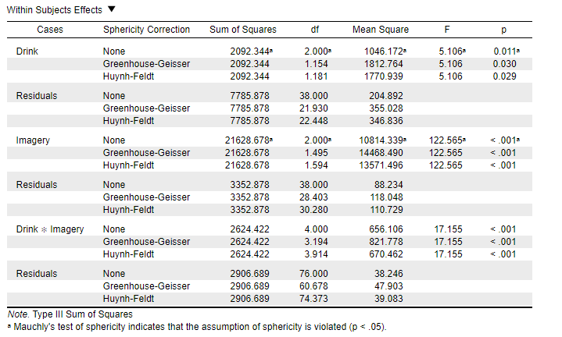
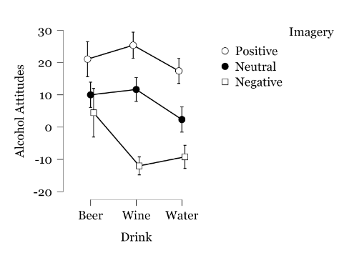

Slide 50
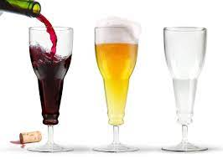
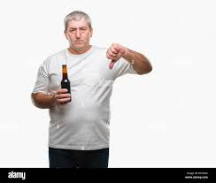



Example, Practice, and Discuss

Slide 51
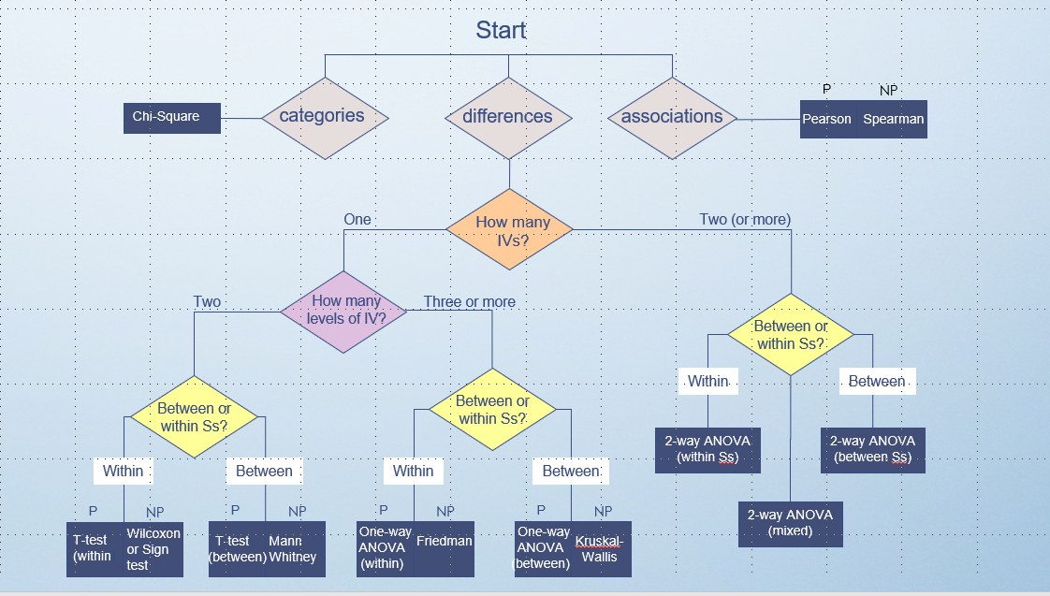

Slide 52
Day 4 Afternoon : Statistical Workshop
Download and install JASP on your computer

